Slide 1
Problem Solving & search
18BTCS504
Prof. Suresh Kapare

Slide 2
Problem solving agent (goal based)
decide what to do by finding sequences of actions that lead to desirable states.
Problem?
Solution?
General Purpose Search Algorithm to solve problem-
Analysis of algorithms
Goal formulation, based on the current situation and the agent's performance measure, is the first step in problem solving- Tour Agent Example.

Slide 3
The agent's task is to find out which sequence of actions will get it to a goal state.
Problem formulation is the process of deciding what actions and states to consider, given a goal. (To avoid many small states)
An agent with several immediate options of unknown value can decide what to do by just examining different possible sequences of actions that lead to states of known value, and then choosing the best sequence.
This process of looking for such a sequence is called Search.
A search algorithm takes a problem as input and returns a solution in the form of an action sequence. (a solution in the form of an action sequence)
Once a solution is found, the actions it recommends can be carried out. This is called the Execution phase.
"formulate, search, execute"

Slide 4
Environment is Static, observable, deterministic. Initial state known

Slide 5
Well-defined problems and solutions
Initial state
A description of the possible actions available to the agent. The most common formulation uses a successor function. Given a particular state x, SUCCESSOR-FN(x) returns a set of (action, successor) ordered pairs, where each action is one of the legal actions in state x and each successor is a state that can be reached from x by applying the action.
Ex. (Go(Mumbai), In (Airport))
state space of the problem = Initial State + Successor function (set of all states)
A path in the state space is a sequence of states connected by a sequence of actions.
The goal test, which determines whether a given state is a goal state.
A path cost function that assigns a numeric cost to each path. reflects its own performance measure. The step cost of taking action a to go from state x to state y is denoted by c(x, a, y).
Above elements define a problem, gathered into single data structure given as input to a problem-solving algorithm.
A solution to a problem is a path from the initial state to a goal state. Optimal Solution has low path cost.

Slide 6
TOY Problems
The vacuum world
States: The agent is in one of two locations, each of which might or might not contain dirt. Thus there are 2 x 2^2 = 8 possible world states.
Initial state: Any state can be designated as the initial state.
Successor function: This generates the legal states that result from trying the three actions (Left, Right, and Suck). The complete state space is shown in Figure 3.3.
Goal test: This checks whether all the squares are clean.
Path cost: Each step costs 1, so the path cost is the number of steps in the path.

Slide 7
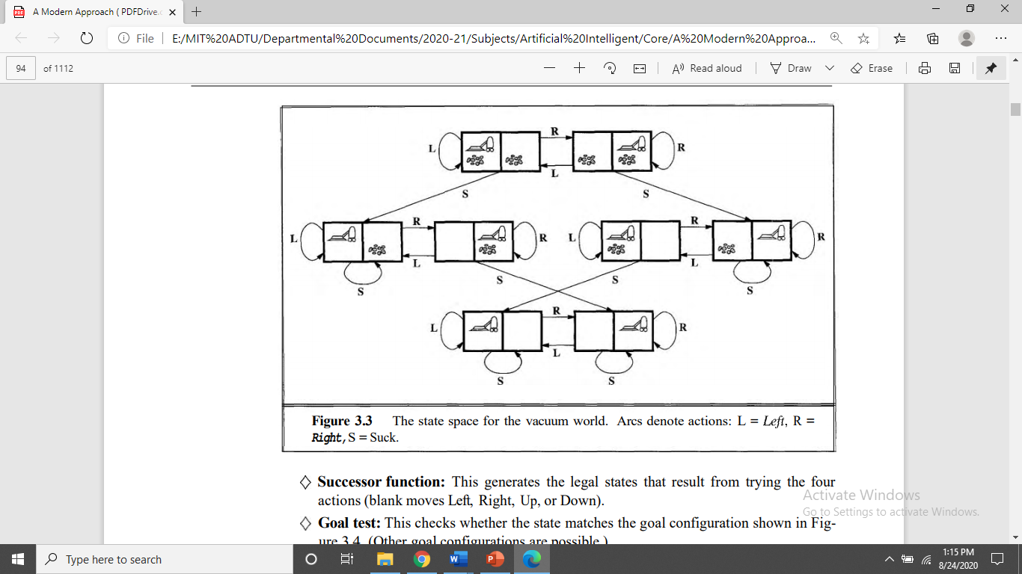

Slide 8
The 8-puzzle
consists of a 3 x 3 board with eight numbered tiles and a blank space
A tile adjacent to the blank space can slide into the space
object is to reach a specified goal state, such as the one shown on the right of the figure
States: A state description specifies the location of each of the eight tiles and the blank in one of the nine squares
Initial state: Any state can be designated as the initial state. Note that any given goal can be reached from exactly half of the possible initial states
Successor function: This generates the legal states that result from trying the four actions (blank moves Left, Right, Up, or Down).
Path cost: Each step costs 1, so the path cost is the number of steps in the path.
Goal test: This checks whether the state matches the goal configuration shown in Fig

Slide 9
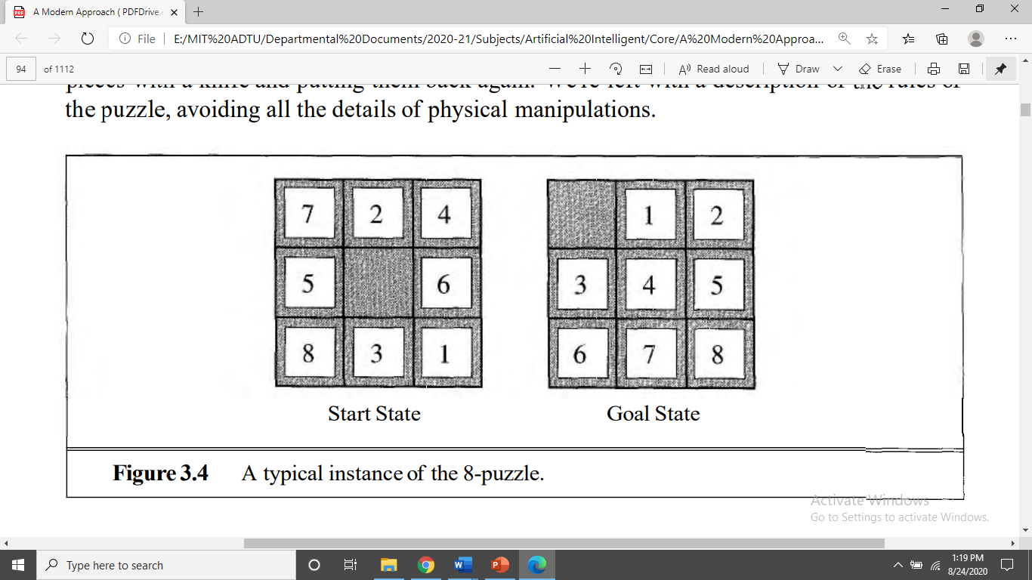

Slide 10
Analysis
belongs to the family of sliding-block puzzles, which are often used as test problems for new search algorithms in AI.
This general class is known to be NP-complete, so one does not expect to find methods significantly better in the worst case than the search.
The 8-puzzle has 9!/2 = 181,440 reachable states and is easily solved.
The 15-puzzle (on a 4 x 4 board) has around 1.3 trillion states, and random instances can be solved optimally in a few milliseconds by the best search algorithms.
The 24-puzzle (on a 5 x 5 board) has around loz5 states, and random instances are still quite difficult to solve optimally with current machines and algorithms.

Slide 11
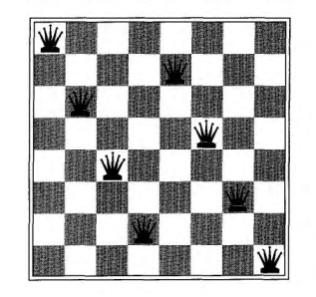
the 8-queens problem
to place eight queens on a chessboard such that no queen attacks any other.
There are two main kinds of formulation.
An incremental formulation involves operators that augment the state description, starting with an empty state; for the 8-queens problem, this means that each action adds a queen to the state.
A complete-state formulation starts with all 8 queens on the board and moves them around. In either case, the path cost is of no interest because only the final state counts.

Slide 12
States: Any arrangement of 0 to 8 queens on the board is a state.
Initial state: No queens on the board.
Successor function: Add a queen to any empty square.
Goal test: 8 queens are on the board, none attacked.
In this formulation, we have 64 . 63 . . .57 =1.8 x 10^14 possible sequences to investigate. A better formulation would prohibit placing a queen in any square that is already attacked:
States: Arrangements of n queens (0 <= n <= 8), one per column in the leftmost n columns, with no queen attacking another are states.
Improved Successor function: Add a queen to any square in the leftmost empty column such that it is not attacked by any other queen.
This formulation reduces the 8-queens state space from 3 x 10^14 to just 2,057, and solutions are easy to find.
On the other hand, for 100 queens the initial formulation has roughly 10^400 states whereas the improved formulation has about 10 ^52 states.

Slide 13
Real-world problems
Route-finding algorithms are used in a variety of applications, such as routing in computer networks, military operations planning, and airline travel planning systems
Consider a simplified example of an airline travel problem specified as follows:
States: Each is represented by a location (e.g., an airport) and the current time
Initial state: This is specified by the problem
Successor function: This returns the states resulting from taking any scheduled flight (perhaps further specified by seat class and location), leaving later than the current time plus the within-airport transit time, from the current airport to another.
Goal test: Are we at the destination by some prespecified time.
Path cost: This depends on monetary cost, waiting time, flight time, customs and immigration procedures, seat quality, time of day, type of airplane, frequent-flyer mileage awards, and so on.

Slide 14
The traveling salesperson problem (TSP) is a touring problem in which each city must be visited exactly once. The aim is to find the shortest tour. The problem is known to be NP-hard, but an enormous amount of effort has been expended to improve the capabilities of TSP algorithms. In addition to planning trips for traveling salespersons, these algorithms have been used for tasks such as planning movements of automatic circuit-board drills and of stocking machines on shop floors

Slide 15
A VLSI layout problem requires positioning millions of components and connections on a chip to minimize area, minimize circuit delays, minimize stray capacitances, and maximize manufacturing yield.
The layout problem comes after the logical design phase, and is usually split into two parts: cell layout and channel routing.
In cell layout, the primitive components of the circuit are grouped into cells, each of which performs some recognized function. Each cell has a fixed footprint (size and shape) and requires a certain number of connections to each of the other cells. The aim is to place the cells on the chip so that they do not overlap and so that there is room for the connecting wires to be placed between the cells.
Channel routing finds a specific route for each wire through the gaps between the cells. These search problems are extremely complex, but definitely worth solving.

Slide 16
Uniformed search strategies
This section covers five search strategies that come under the heading of uninformed search (also called blind search).
The term means that they have no additional information about states beyond that provided in the problem definition.
All they can do is generate successors and distinguish a goal state from a nongoal state. Strategies that know whether one non goal state is "more promising" than another are called informed search or heuristic search strategies.
All search strategies are distinguished by the order in which nodes are expanded

Slide 17
Breadth-first search
Breadth-first search is a simple strategy in which the root node is expanded first, then all the successors of the root node are expanded next, then their successors, and so on. In general, all the nodes are expanded at a given depth in the search tree before any nodes at the next level are expanded.
Implemented by calling TREE-SEARCH with an empty fringe that is a first-in-first-out (FIFO) queue, assuring that the nodes that are visited first will be expanded first.
In other words, calling TREE-SEARCH(problem, FIFO-QUEUE()) results in a breadth-first search.
The FIFO queue puts all newly generated successors at the end of the queue, which means that shallow nodes are expanded before deeper nodes.

Slide 18
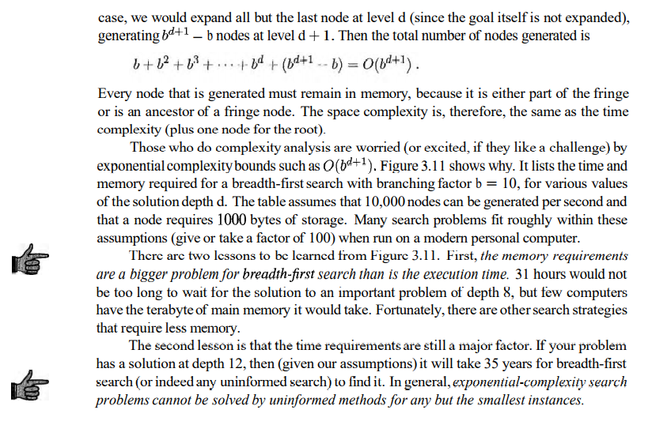

Slide 19
